Slide 1
How to make a science poster for a conference?
Andris Berzins*, Janis Smits, Yaser Silani, Bryan Richards
andris.beerzinsh@gmail.com

Slide 2
What is a poster?
A scientific poster is a visual representation of research findings
The purpose of a poster is to help you talk about your research
This is how you develop you presentation skills
It is not an exam!

Slide 3
General things
You are the most important part of the poster presentation!
Think about the audience you are making your poster for
Check the recommended poster size and orientation
U.S.
48 x 36 in (4x3 feet)
56 x 42 in
Landscape popular
EU
A1 (23.4 x 33.1 in)
A0 (33.1 x 46.8 in)
Portrait popular
Different regions of the world will have different standards

Slide 4
Basic design rules
Make the poster eye-catching and pretty
Remember that poster is a visual aid for your presentation, not a scientific paper:
Less text is better.
Don’t waste space on a written abstract
Pick pictures/graphs over text where possible
It is a big piece of paper, “break it down” to human-friendly chunks
Give the reader “space to breathe”: leave plenty of white space. Be critical about what is important in your research.

Slide 5
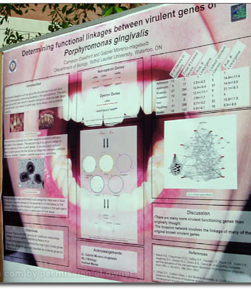
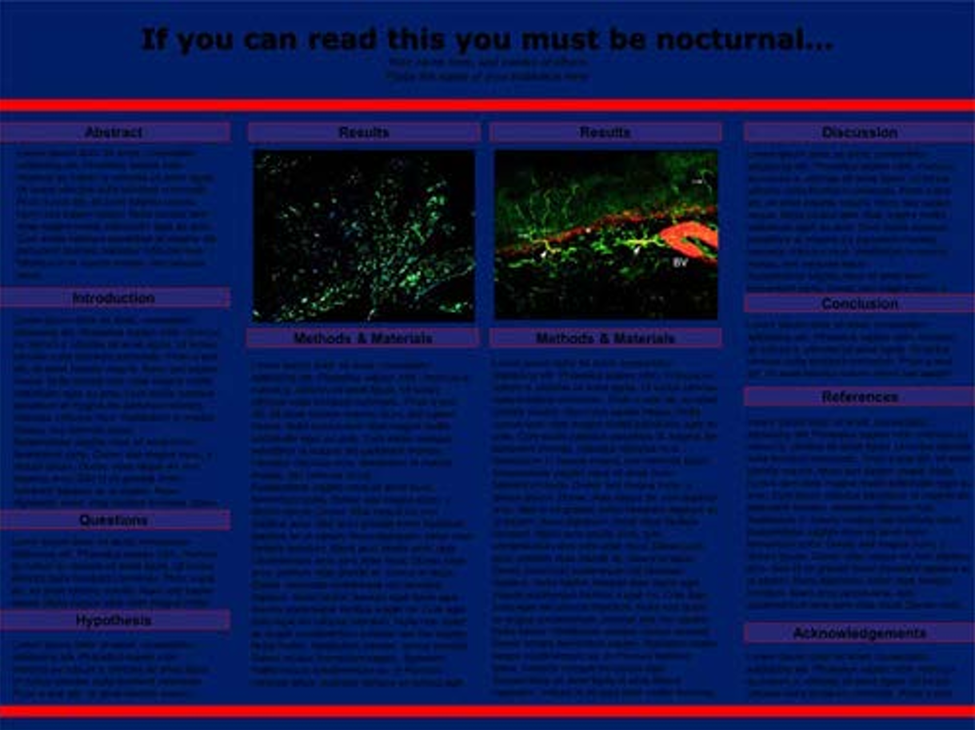

Bad examples

Slide 6
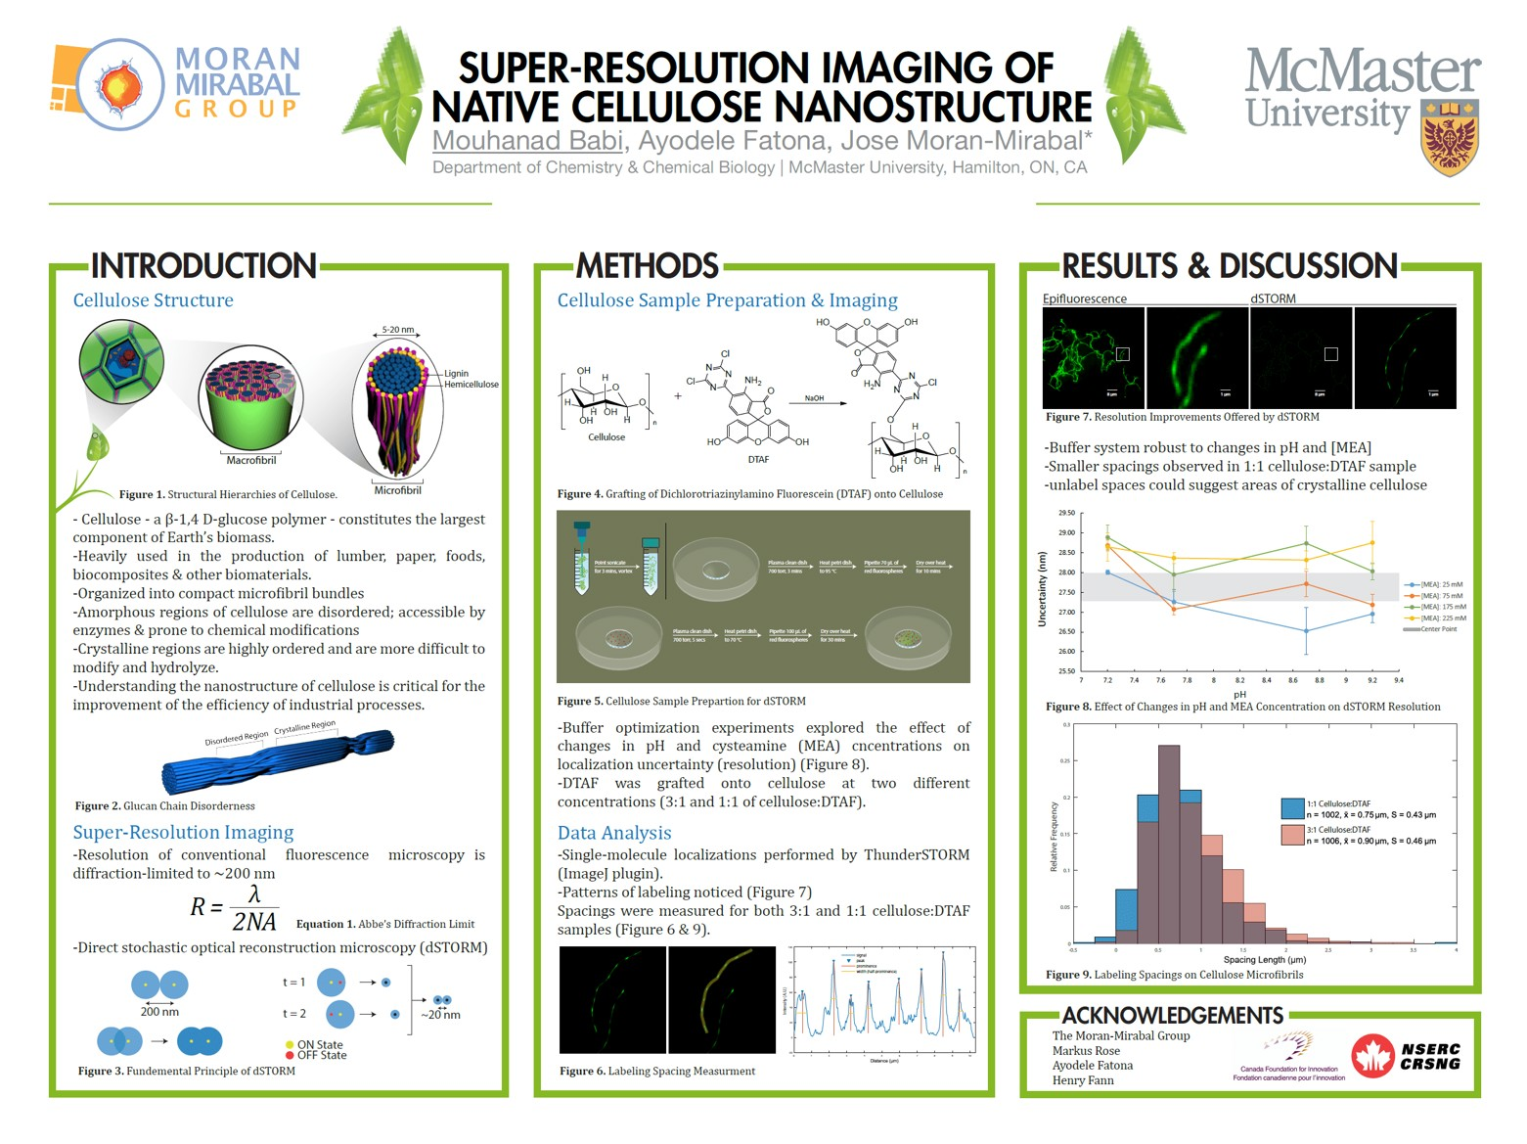
“Good” example and suggestions for layout

Slide 7
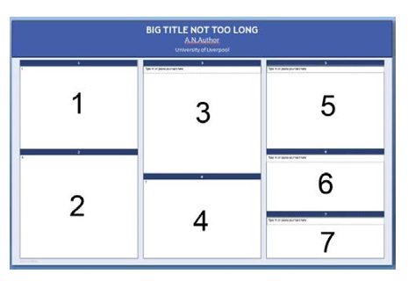

Title, authors, affiliations, logos
Big bold title in 72pt or larger
Authors
Not just you, include people who worked with you
Author affiliations
Include the place where you did the research
People can have multiple affiliations
Logos (optional)

Slide 8
Background and motivation
Methods 2
Results 2
Overview of the system you’re studying
Basics of the math you’re using
Etc.
Results – observed parameter Y as a function of experimental parameter X
Theory prediction vs experimental observation
What is the point of your research?
Why should anyone be interested?
Results 1
Methods 1
Results – observed parameter Y as a function of experimental parameter X
Theory prediction vs experimental observation
Conclusions
Schematic of the experimental apparatus
Basic equation I used to model something
Overview of physical model proposed
Etc.
What did you learn?
What can you do now that you couldn’t before?
Should tie back to motivation
Acknowledgements
Big ups to funding
Big ups to people

Slide 9
Color
Contrast:
https://webaim.org/resources/contrastchecker/
Compatibility:
https://color.adobe.com/create/color-wheel
https://mycolor.space/

Slide 10
Miscellaneous design tips
Image resolution
Too big is bad – problems at the printers with huge files
To small is bad – visible pixelization
Text size: always aim for larger
Text hierarchy – bigger is more important
Accents – extremely useful if you don’t overdo it
Be mindful of axes labels and tick marks
When picking fonts remember readability is priority
Bullet points are your friends
Try avoiding confusing pictures

Slide 11
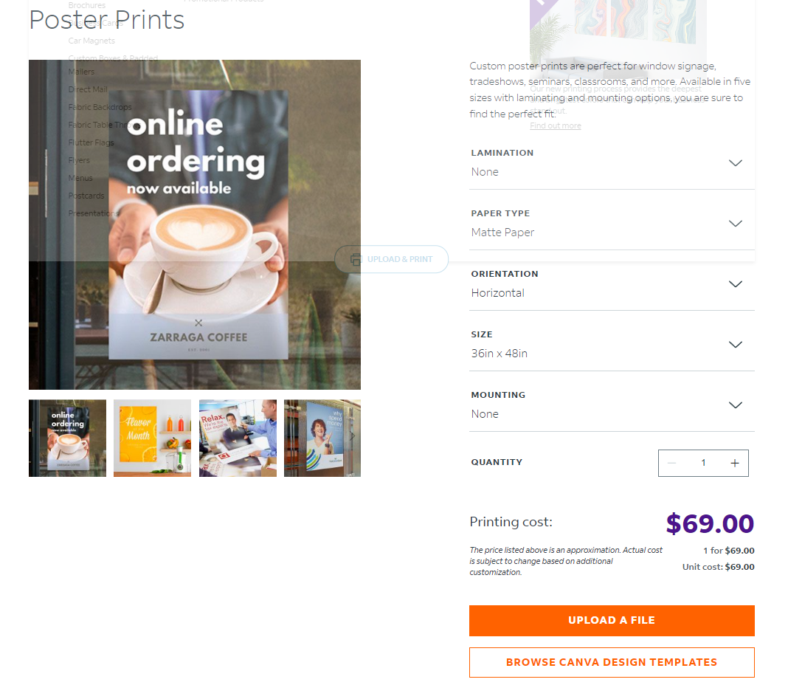
Poster is ready – now what
Save as a .pdf file.
Open the .pdf file and look at it!
Check for missing figures, spelling errors, problems with special characters
Print it out on letter size page! Can you read everything?
Send it for printing, 2 options
Printed here at UNM (no charge). Submit on Thursday the week of the seminar (August 1st) before 15:00.
Print at your nearest FedEx (costs money). You can submit the previous day online and pick it up the next morning.

Slide 12
The 2 minute presentation
You need a roughly 2 minutes or less prepared speech covering:
The motivation of your research
Methods used
Key results and conclusions
Provide broader context to your work
Your instinct will be to immediately zero in on what you did this summer
Most people are not from your field of research
Have not that much mental resources left
Might interrupt you in the first couple of seconds

Slide 13
Miscellaneous presentation tips
Winner attitude (focus on the success)
Expect to be interrupted and welcome it
Speak clearly and prepare to talk loudly
If (when) you don’t know something – don’t panic, and shut the conversation down:
“I’m unsure, but that didn’t seem to play such a large role”
“In what perspective are you asking this?”
“I have no answer for this, but I know that…”
Feel free to ask what is the background of your “poster guests”

Slide 14
Emotional tips and pitfalls
Don’t obsess about being 100% knowledgeable about absolutely everything
Start working on this earlier than you think you need to
If there are any problems, or you feel unsure about your research or overwhelmed – don’t cancel or bail, reach out to us first!
Have fun, be proud of the work you’ve put in!

Slide 15
Want to read more?
Good overall suggestions:
Powell, K. Presentations: Billboard science. Nature 483, 113–115 (2012). https://doi.org/10.1038/nj7387-113a
Technical suggestions:
https://www.animateyour.science/post/best-examples-of-scientific-posters

Slide 16
Workshop time
Figure out the software and set up an appropriate canvas
Powerpoint, Inkscape, Illustrator are all good options
Then it is just managing text boxes, boxes, and pictures

